Slide 1


Crash Course on GIT
Carlos Diego N. Damasceno - https://github.com/damascenodiego/

Slide 2


Crash Course on GIT
Scott Chacon and Ben Straub. 2014. Pro Git (2nd ed.). Apress, Berkely, CA, USA.
Eric Sink. 2011. Version Control by Example (1st ed.). PYOW Sports Marketing.

Slide 3




Agenda
Version Control
Version Control Systems (VCS)
Types of VCS
Crash Course on Git
git history
Basic concepts
Installing git
Getting started
GitHub 101
Eclipse Git
References++

Slide 4

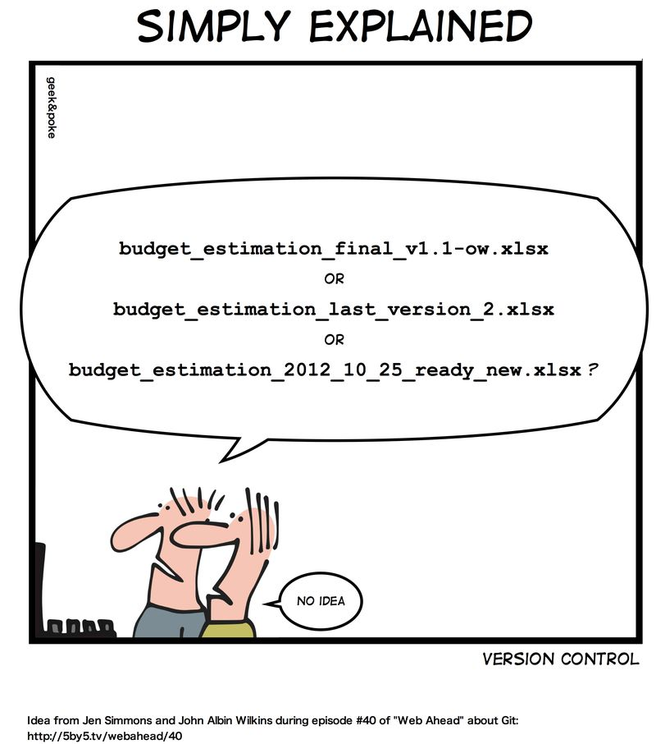

Slide 5
Version Control
Software Configuration Management (SCM)
Umbrella activity [Pressman, 2010]
“The art of identifying, organizing, and controlling modifications to software being developed”
Maximize productivity by minimizing mistakes → Confusion!!!
Tasks
Identification
Version control
Change Control
Configuration auditing
Reporting
Pressman, R. S. Software engineering: A practitioner’s approach. 5th ed. McGraw-Hill Higher Education, 2001.

Slide 6

Version Control
“The task of keeping a software system consisting of many versions and configurations well organized”
[Kemper & Oxley, 2012]
Kemper C., Oxley, I. 2012. Foundation Version Control for Web Developers. Appress.

Slide 7



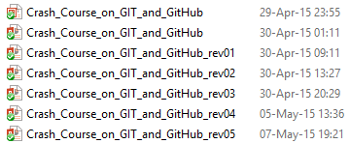
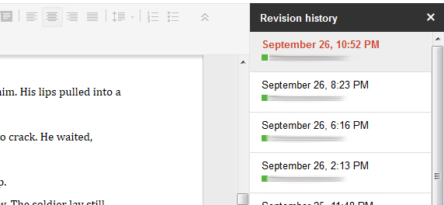
Version Control

Slide 8
Version Control System
“A software that helps developers on a software team to work together and also archives a complete history of their work.”
[Sink, 2011]
Eric Sink. 2011. Version Control by Example (1st ed.). PYOW Sports Marketing.

Slide 9

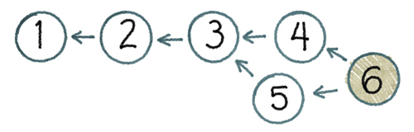
Version Control System
Three basic goals of a Version Control System (VCS) [Sink, 2011]
People must be able to work simultaneously, not serially.
No conflicting changes
Keep every version of everything that has ever existed
Eric Sink. 2011. Version Control by Example (1st ed.). PYOW Sports Marketing.

Slide 10
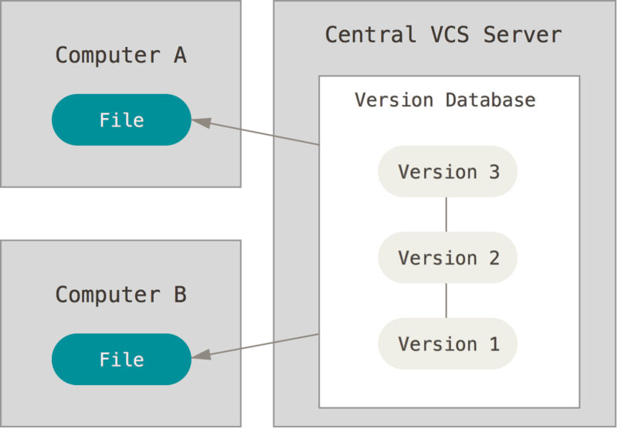
Types of Version Control Systems
Centralized VCS (CVCS)
Central Server
Collaborative work
Single point of failure
Examples
Concurrent Version System (CVS)
http://www.nongnu.org/cvs
Apache Subversion (SVN)
https://subversion.apache.org
Most popular CVCS
Centralized version control [Chacon & Straub, 2014]
Scott Chacon and Ben Straub. 2014. Pro Git (2nd ed.). Apress, Berkely, CA, USA.

Slide 11
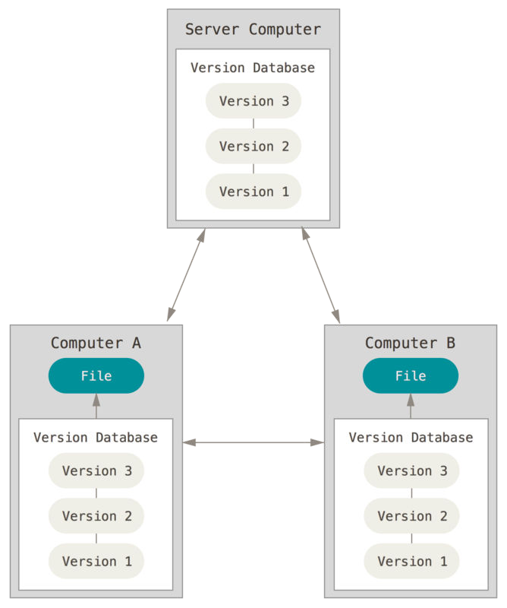
Types of Version Control Systems
Distributed VCS (DVCS)
Remote Server
Collaborative work
Several remote servers
Full backup
Examples
Mercurial (hg)
http://mercurial.selenic.com/
git
http://git-scm.com/
https://github.com/
Distributed version control [Chacon & Straub, 2014]
Scott Chacon and Ben Straub. 2014. Pro Git (2nd ed.). Apress, Berkely, CA, USA.

Slide 12


Slide 13



Crash Course (git history)
Linux kernel
Linus Torvalds
Open source software project of fairly large scope
1991–2002: Changes passed around as patches/archived files
2002: Proprietary DVCS → BitKeeper
2005: Linux community and the BitKeeper company relationship broke down
Free-of-charge status was revoked

Slide 14


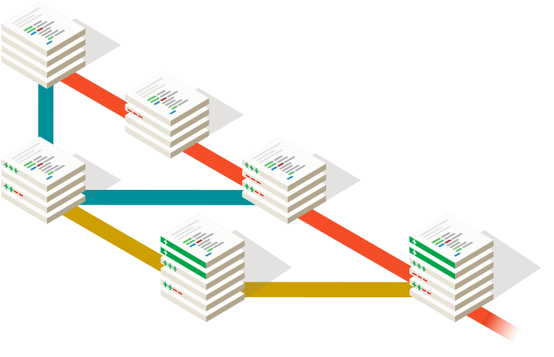

Crash Course (git history)
VCS requirements
Speed
Simple design
Strong support for non-linear development
Thousands of parallel branches
Fully distributed
Able to handle large projects efficiently
e.g. Linux kernel

Slide 15

Crash Course (git history)

Slide 16
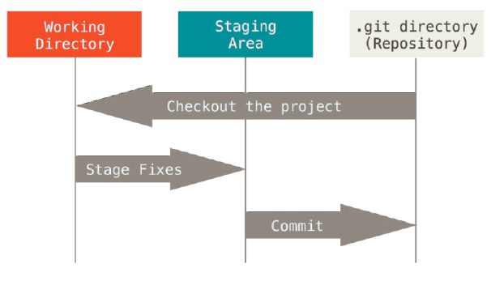

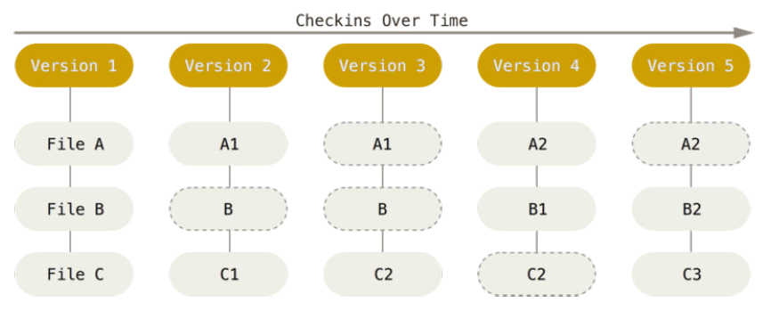
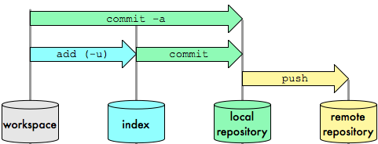
Crash Course (Basic concepts)
Basic concepts
Snapshots
Integrity
Generally only adds data
The three states
Storing data as snapshots of the project over time.
24b9da6552252987aa493b52f8696cd6d3b00373
The three stages: Working directory, staging area, and Git directory.
Notes:
Snapshot:
the way git keep versions.
Each snapshot contains all the files versioned.
New files are inserted and not edited files reference the last commit (saves space)
Integrity:
Creates a hash for each commit/file.
Enable integrity checking
Generally only adds data
Often you will only save stuff in your rep (commit)
You can also delete info from there, however it is not common.
Of course you can also grab older commits (pull/fetch/chechout)
3 states
Work dir: where you edit
Stage area: intermediate step before commit/rep
.git dir (rep): where the versions are locally kept

Slide 17


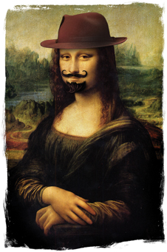
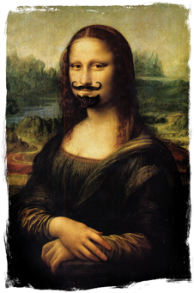

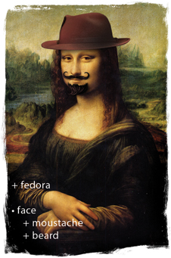

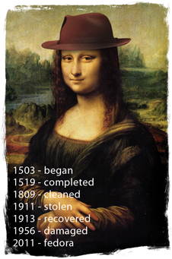
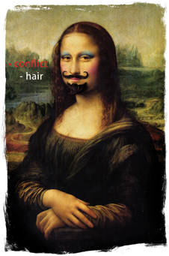
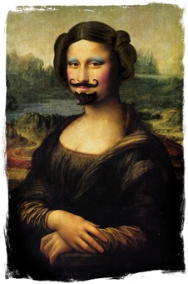

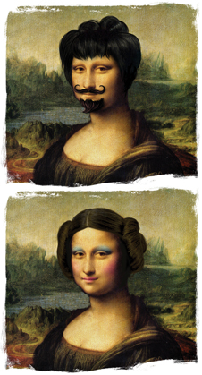
Crash Course (Basic concepts)
Basic operations
Add
Edit
Delete
Rename
Status
Diff
Revert
Log
Tag
Branch
Merge
Resolve
Eric Sink. 2011. Version Control by Example (1st ed.). PYOW Sports Marketing.
Notes:
Branch!!!!!!
A---B---C topic
/
H---I---D---E---F---G master

Slide 18

Crash Course (Installing git)
Windows - http://git-scm.com/download
Linux - Package management tool
# ~ apt-get install git
Notes:
Access http://git-scm.com/download

Slide 19
Crash Course on GIT
Getting Started
Notes:
Create a directory named ”gitcourse” → mkdir gitcourse
Change for this directory → cd gitcourse

Slide 20
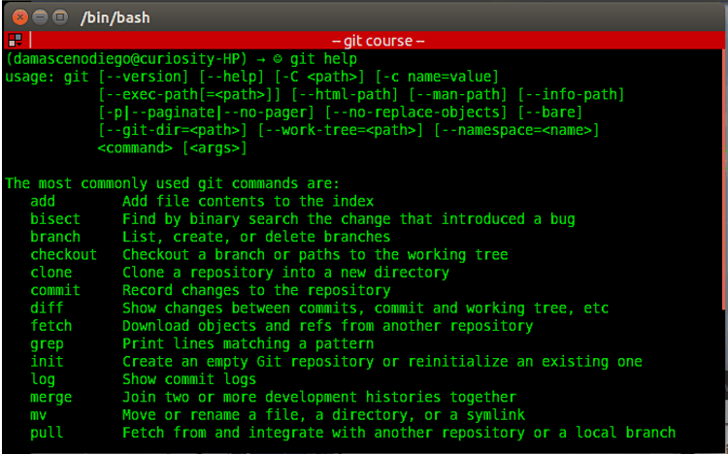
Crash Course (Getting Started)
git help
git help <parameter>
Notes:
git help
It shows the git manual.

Slide 21
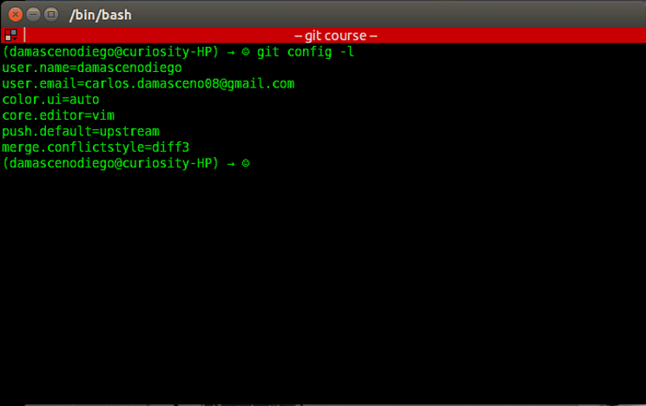
Crash Course (Getting Started)
git config -l
git config --global <variable> <parameter>
Notes:
git config
This command allows to check and edit the settings of a specific project. E.g. username (user.name) and email (user.email).
IMPORTANT TO SET UP PARAMETERS!!! → “TELL ME WHO YOU ARE!!!!!!!”
git config -l
git config user.name
git config user.email
git config –global user.name
git config –global user.email

Slide 22
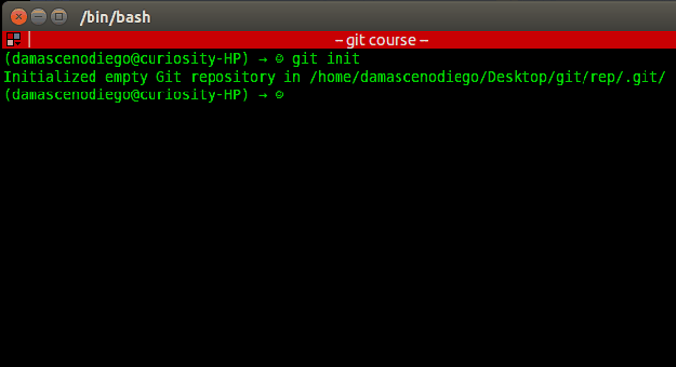
Crash Course (Getting Started)
git init
Notes:
git init
This command allows to setup a git repository. It creates the .git directory – a Git repository skeleton.
At this point nothing is tracked!

Slide 23
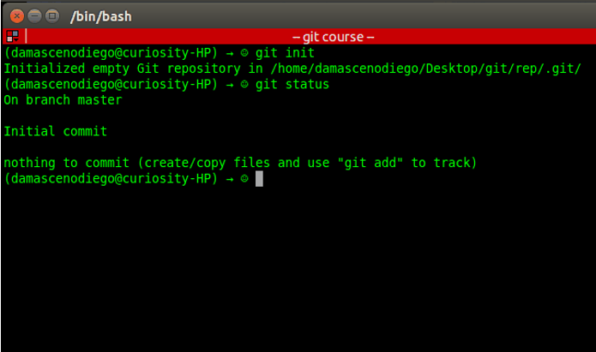
Crash Course (Getting Started)
git status
Notes:
git status
This command shows differences between working directory, staging area and last commit in the repository.

Slide 24
Crash Course (Getting Started)
The three stages: Working directory, staging area, and Git directory.
Notes:
working directory: where your files are located. You edit here
staging area: you keep/organize files before commit
commit
.git dir: files are versioned
Checkout: grab files from rep

Slide 25
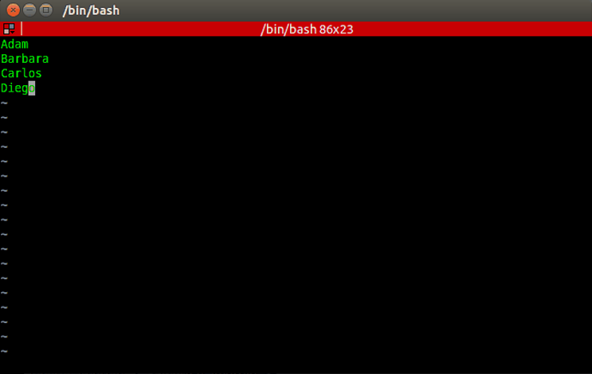
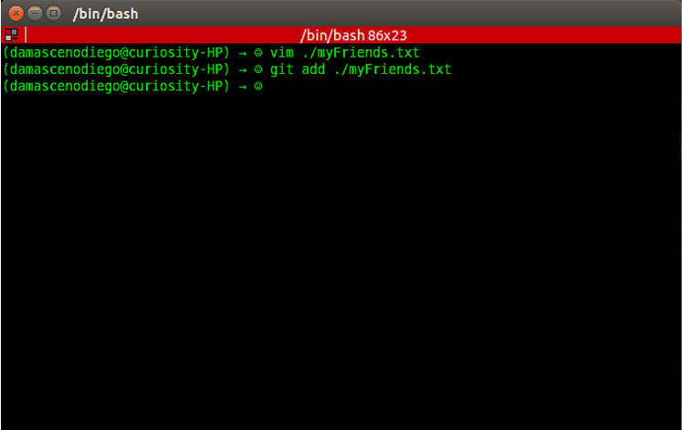
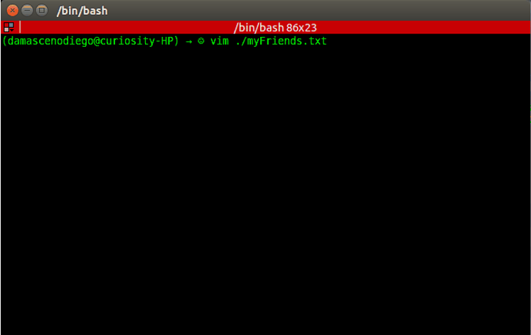
Crash Course (Getting Started)
git add <filenames>
Adam
Barbara
Carlos
Diego
Create a list with 4 names of friends (myFriends.txt)
Notes:
git add
This command updates the index (staging area) using the current content found in the working tree (working directory), to prepare the content staged for the next commit.
Create the list with the same names!!!!!!

Slide 26
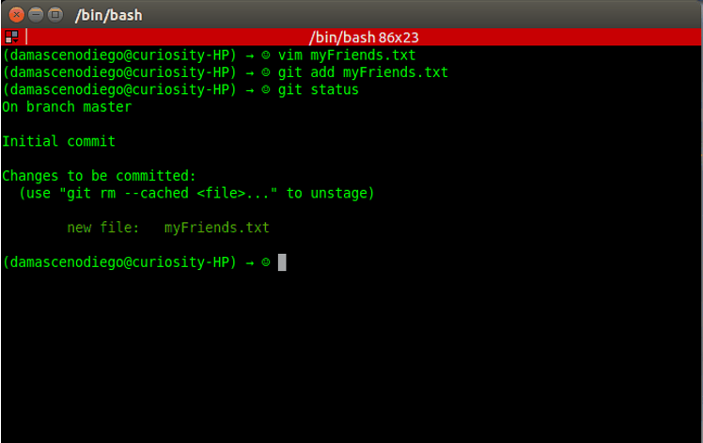
Crash Course (Getting Started)
git status

Slide 27
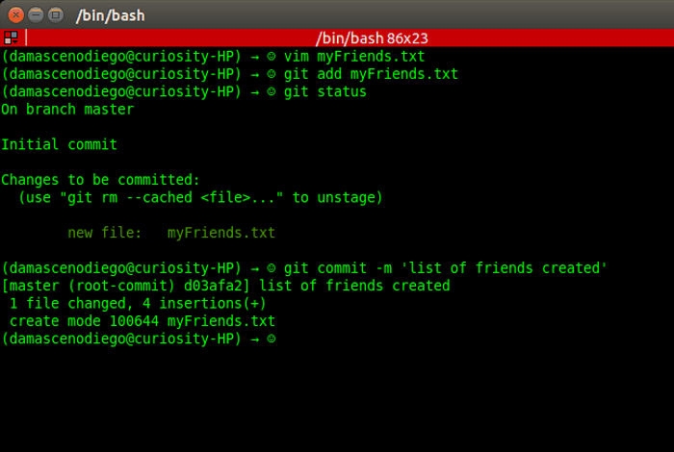
Crash Course (Getting Started)
git commit –m ‘<message>’
‘list of friends created’
Notes:
git commit
Stores the current contents of the index (staging area) in a new commit along with a log message from the user describing the changes.

Slide 28
Crash Course (Getting Started)
unversioned
git commit
git init

Slide 29
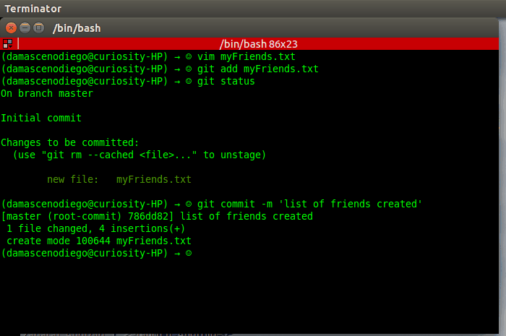
Crash Course (Getting Started)
git status

Slide 30
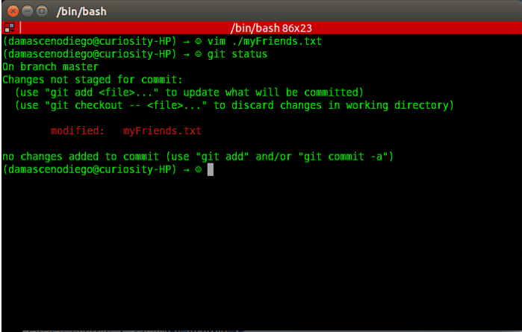
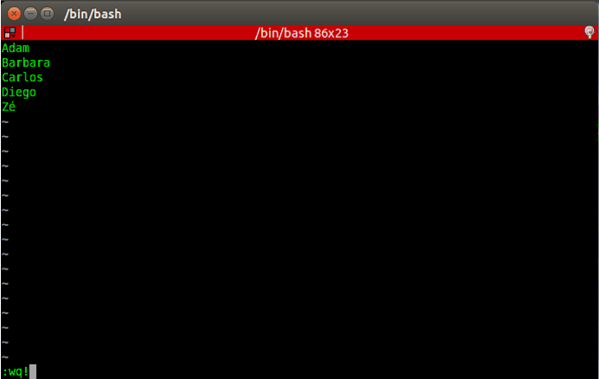
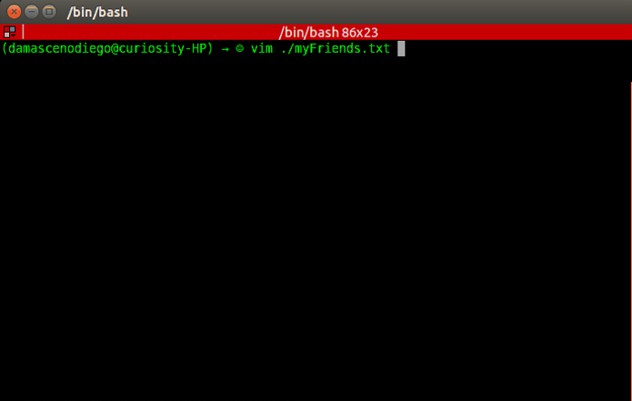
Crash Course (Getting Started)
Add another friend name (Zé)
at the end of myFriends.txt and run
git status
Notes:
Let’s Edit the file and append a new name

Slide 31
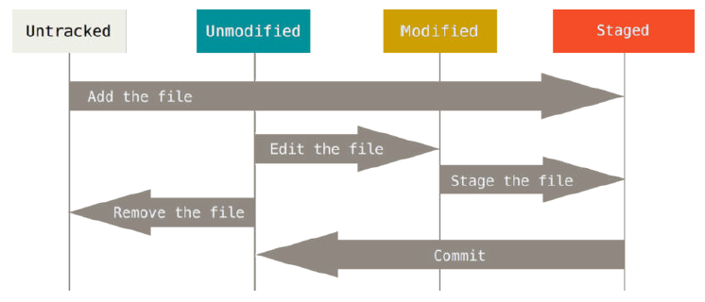
Crash Course (Getting Started)
The lifecycle of the status of your files.
Notes:
What happens with the files on git

Slide 32
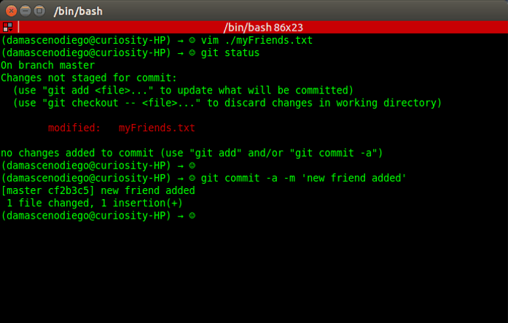
Crash Course (Getting Started)
git commit –a –m ‘<message>’
‘new friend added’

Slide 33
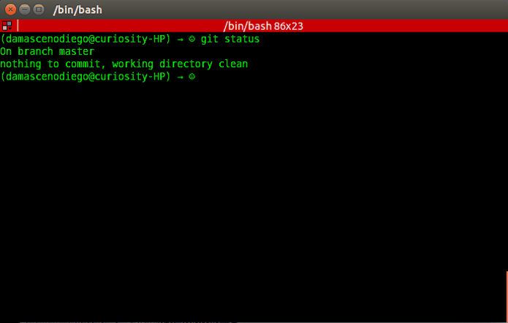
Crash Course (Getting Started)
git status

Slide 34
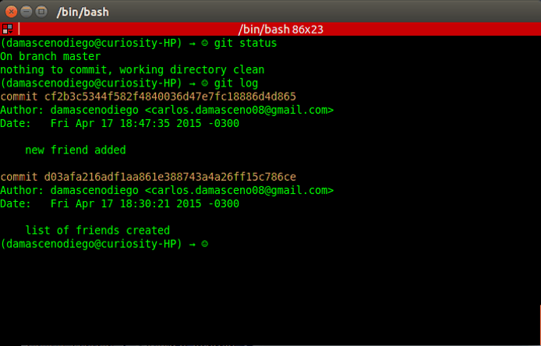

Crash Course (Getting Started)
git log

Slide 35
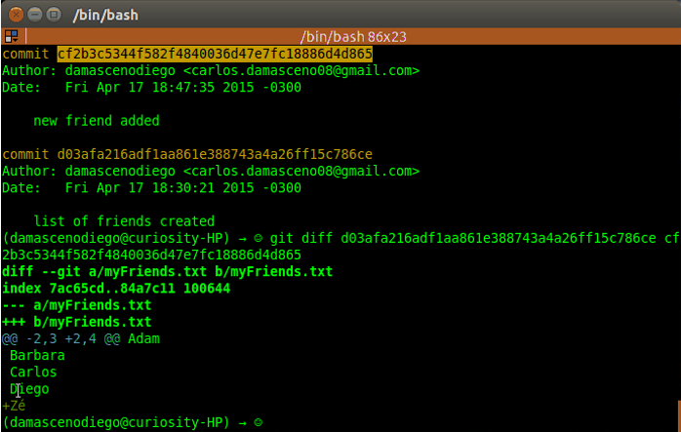
Crash Course (Getting Started)
git diff <hash0> <hash1>
Notes:
git log
Shows the commit logs.

Slide 36
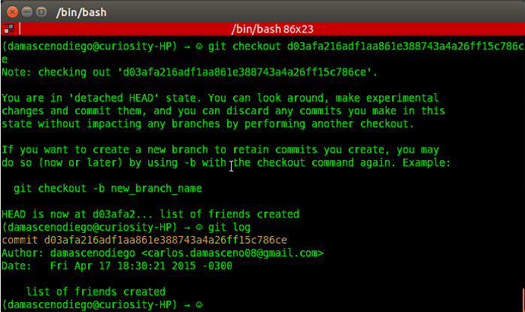
Crash Course (Getting Started)
git checkout <hash>
Notes:
git checkout
Updates files in the working tree to match the version in the index or the specified tree.

Slide 37
Crash Course (Getting Started)
git checkout <hash>

Slide 38
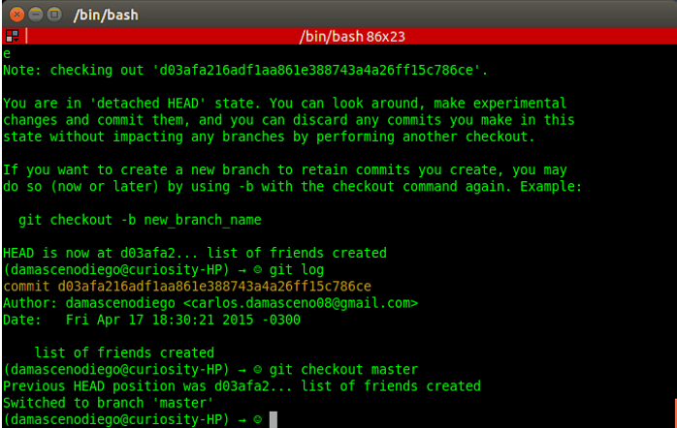
Crash Course (Getting Started)
git checkout master

Slide 39
Crash Course (Getting Started)
git checkout master

Slide 40
Crash Course (Getting Started)
<otherList>
Brian
Rafael
<master>
Adam
Barbara
Carlos
Diego
Zé
Notes:
Lets create ‘other list’!
However we stil want to keep the original one (master)
Ho can we do it?

Slide 41
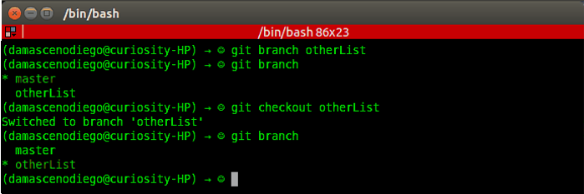
Crash Course (Getting Started)
git branch <branch name>
git branch
git checkout <branch name>
otherList
Notes:
git branch
The command creates a new branch head named <branch name>.
With no arguments, branches are listed; the current branch will be highlighted with an asterisk.

Slide 42
Crash Course (Getting Started)
git branch <branch name>
git checkout <branch name>

Slide 43
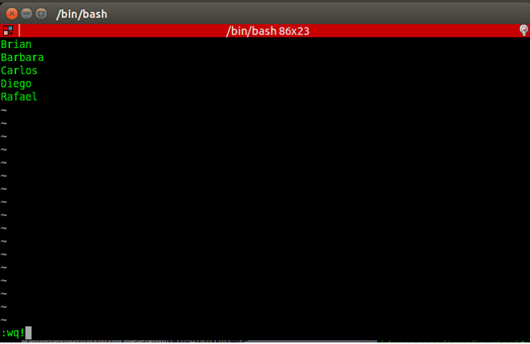
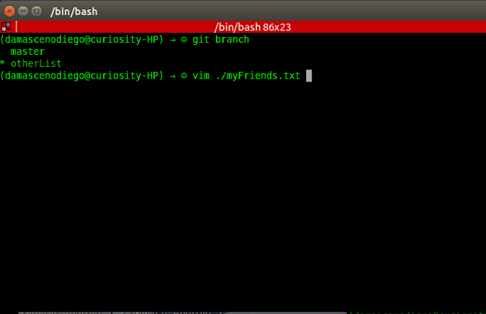
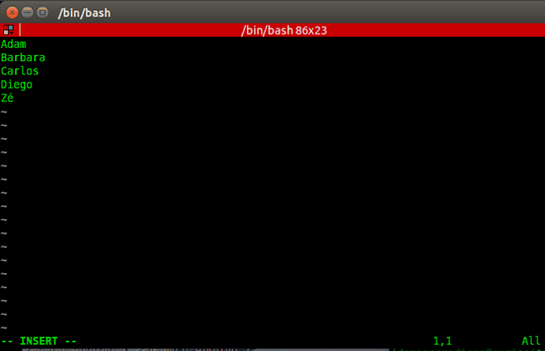
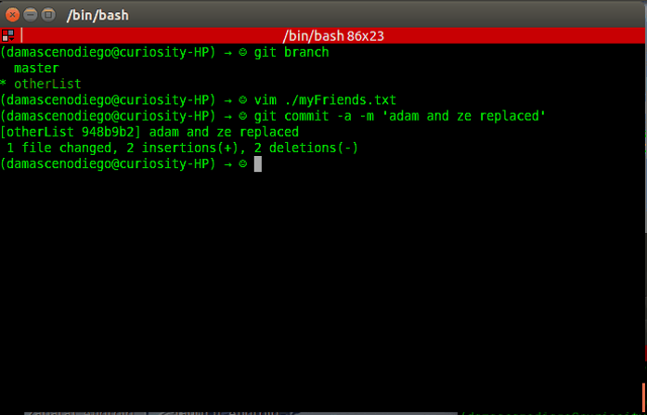
Crash Course (Getting Started)
Replace some names (Adam and Zé)
by other names (Brian and Rafael)
and run
git commit -a -m <message>
git commit –a –m ‘adam and ze replaced'

Slide 44
Crash Course (Getting Started)
git commit -a -m <message>

Slide 45
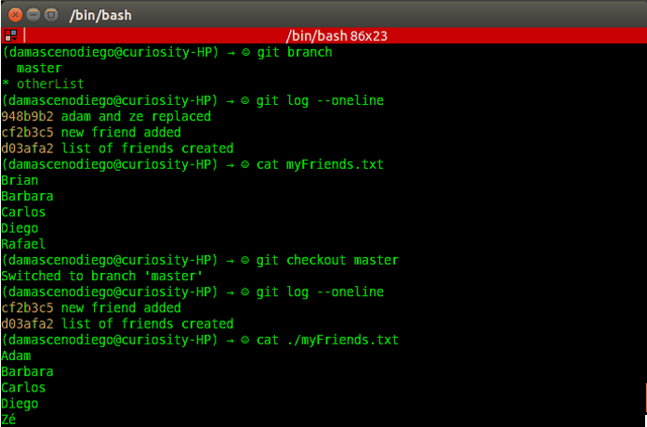
Crash Course (Getting Started)
Check log on both branches
(master and otherList)
using
git log --oneline
otherList
master

Slide 46
Crash Course (Getting Started)
<master>
Adam
Barbara
Carlos
Diego
Zé
<master>
(other version)
Jane
Notes:
Lets update the master list

Slide 47
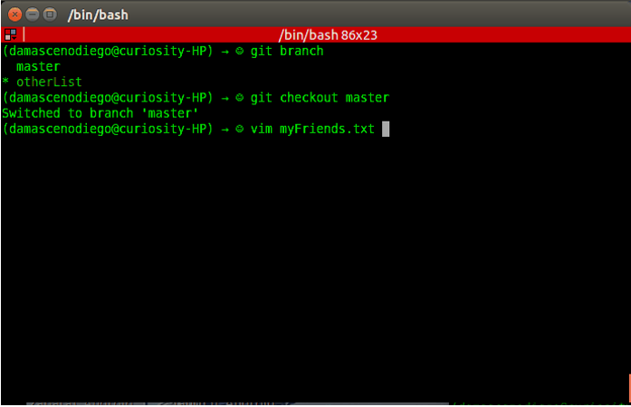
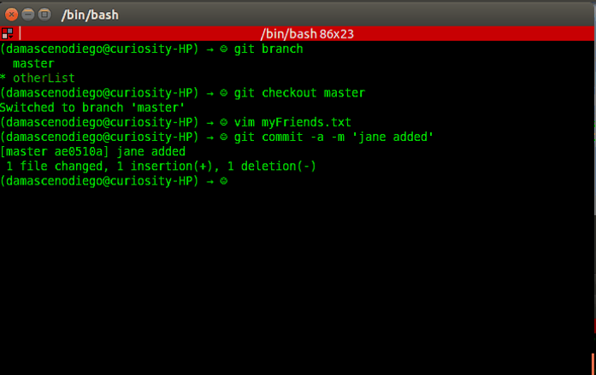
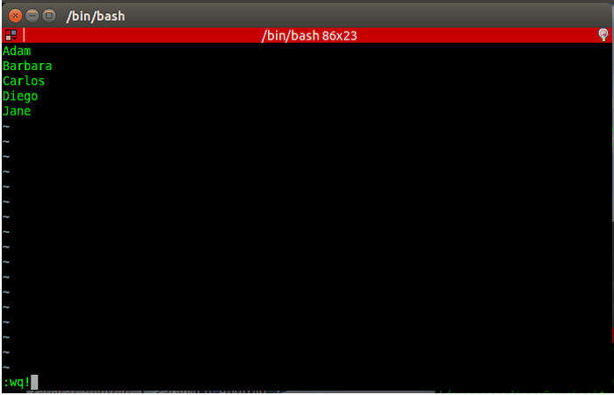
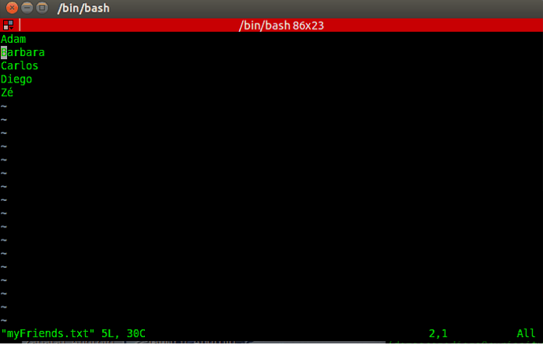
Crash Course (Getting Started)
git checkout master
Replace the last name by a different one git commit –a –m ‘jane added’

Slide 48
Crash Course (Getting Started)
git commit -a -m <message>
git chechout master

Slide 49
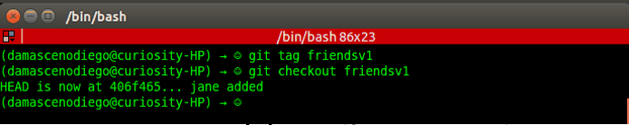
Crash Course (Getting Started)
git tag <tag name>
git checkout <tag name>
friendsv1
git checkout <hash/branch name/tag name>
Notes:
git tag
Create, list, delete or verify tag references.
Logic unit

Slide 50
Crash Course (Getting Started)
git tag <tag name>

Slide 51
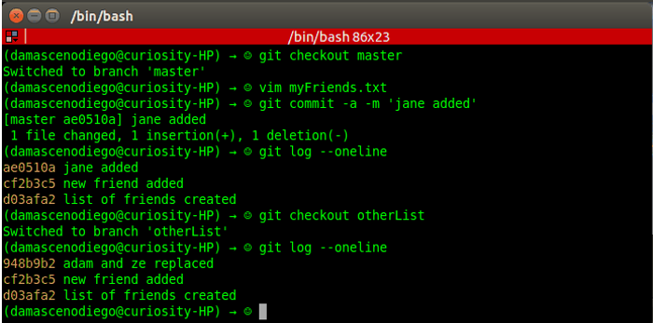
Crash Course (Getting Started)
Check log on both branches
(master and otherList)
using
git log --oneline
master
otherList

Slide 52
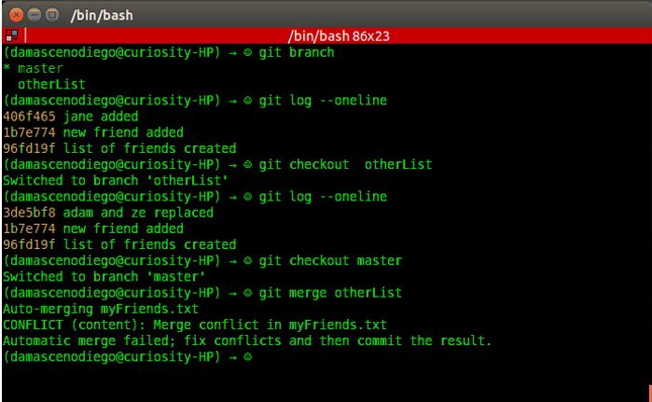
Crash Course (Getting Started)
git merge <branch to be merged with the current>
master
otherList
git merge
otherList
Notes:
git merge
Join development histories together.
Attention to conflicting modifications!!!

Slide 53

Crash Course (Getting Started)
No conflict! ☺
HEAD
(master branch)
Common ancestor
otherList branch
Notes:
Adam replaced by Brian → the common ancestor also had Adam then git assumes the modification can be accepted
However, what about ze? Will it be replaced by rafael or jane?

Slide 54


Crash Course (Getting Started)
(After fixing conflict)
git add ./myFriends.txt
git commit

Slide 55
Crash Course (Getting Started)
git merge <branch name>
git commit -a -m <message>

Slide 56

Crash Course (Getting Started)
git log --oneline --graph

Slide 57

Crash Course (Getting Started)

Slide 58

Crash Course (Getting Started)

Slide 59
Crash Course on GIT
GitHub 101

Slide 60



Crash Course (GitHub 101)
Github
Social coding
Open source
9.3M people collaborating
21.9M repositories
https://github.com
D3: JavaScript virtualization library for SVG and HTML
Ruby on Rails: Popular Web framework based on Ruby

Slide 61

Crash Course (GitHub 101) – Create Account
← Username
← Email
Password
Click here!
https://github.com

Slide 62

Crash Course (GitHub 101) – Create Account

Slide 63


Crash Course (GitHub 101) – Create Repository

Slide 64

Crash Course (GitHub 101) – Create Repository

Slide 65

Crash Course (GitHub 101) – Create Repository
COPY

Slide 66

Crash Course (GitHub 101) – Create Repository
git remote add <repository name> <url>
git push -u <repository name> <branch name>
https://github.com/<YOUR USERNAME>/myFriendsSample.git
origin
master
Notes:
git remote
Manage the set of repositories ("remotes") whose branches you track.
git push
Updates remote refs using local refs, while sending objects necessary to complete the given refs.

Slide 67

Crash Course (GitHub 101) – Create Repository
COPY
Notes:
Create another directory named ”gitclone” → mkdir gitclone
Change for this directory → cd gitclone

Slide 68

Crash Course (GitHub 101) – Clone a Remote Repository
git clone <url> <target directory>
https://github.com/<YOUR USERNAME>/myFriendsSample.git
Notes:
git clone
Clone a repository into a new directory.

Slide 69




Crash Course (GitHub 101) – Push to a Remote Repository
(Sort names on myFriends.txt)
git commit –a –m ‘sorted’
git push –u <repository name> <branch name>
origin
master

Slide 70
Crash Course (GitHub 101) – Pull and Fetch from a Remote Repository
What if a local repository is not up to date?

Slide 71

Crash Course (GitHub 101) – Pull from a Remote Repository
git pull <remote name>
origin
Notes:
git pull
Fetch from and integrate with a local branch.

Slide 72

Crash Course (GitHub 101) – Fetch from a Remote Repository
git fetch <remote name>
origin
Notes:
git fetch
Fetches named heads or tags from one or more other repositories, along with the objects necessary to complete them.

Slide 73



Crash Course (GitHub 101) – Fork Repository

Slide 74

Crash Course (GitHub 101) – Fork Repository

Slide 75

Crash Course (GitHub 101) – Fork Repository

Slide 76

Crash Course (GitHub 101) – Delete a Remote Repository

Slide 77


Crash Course (GitHub 101) – Delete a Remote Repository

Slide 78

Crash Course (GitHub 101) – Delete a Remote Repository

Slide 79
Crash Course (GitHub 101) – Other features
Readme.md
Wiki page
Web diff (code/image)
Pull Request
Comment & Discuss
Issue Tracking

Slide 80

Crash Course (GitHub 101) – Readme.md

Slide 81

Crash Course (GitHub 101) – Wiki Page

Slide 82

Crash Course (GitHub 101) – Web Diff (Code)

Slide 83

Crash Course (GitHub 101) – Web Diff (Image)

Slide 84

Crash Course (GitHub 101) – Pull Request
How can I have commits accepted in another project?

Slide 85


Crash Course (GitHub 101) – Pull Request
Notes:
It is going to be shown later on Egit session

Slide 86

Crash Course (GitHub 101) – Comment & Discuss

Slide 87

Crash Course (GitHub 101) – Issue Tracking

Slide 88
Crash Course on GIT
Eclipse Git (EGit)

Slide 89


Crash Course (Eclipse Git)
Eclipse Git (EGit)
Eclipse plug-in
Allows you to use Git directly within Eclipse IDE
Perspective and Views
Based on the JGit library.
Java library implementing Git functionalities

Slide 90

Crash Course (Eclipse Git) - Exercise
Fork the repository donationGame on GitHub → https://github.com/damascenodiego/donationGame
Clone your fork using Eclipse Git
Create a branch competitors_<nusp> from master branch
Put your competitors in a package named br.usp.icmc.ssc01032015.competitors.id<nusp>
Adapt your classes according to the project specification (extends AbstractCompetitor)
Create a Tournament.java in a package named br.usp.icmc.ssc01032015.tournament.id<nusp>
Make it run your classes. You can use as reference the class Tournament0000000.java
Commit and Push
Create a Pull Request

Slide 91

Notes:
Login in your github account
Enter my rep

Slide 92

Crash Course (Eclipse Git)
Notes:
3) Click on fork

Slide 93

Crash Course (Eclipse Git)
Notes:
4) Copy the rep link

Slide 94

Notes:
Open eclipse

Slide 95

Notes:
Import the rep

Slide 96

Crash Course (Eclipse Git)
Notes:
The rep git

Slide 97

Crash Course (Eclipse Git)
Notes:
Select clone

Slide 98

Crash Course (Eclipse Git)
GitHub Repository
GitHub User/Password
Notes:
Paste the rep url
Write down your github account/password (only will be used during write operations (e.g. push))

Slide 99

Crash Course (Eclipse Git)
Notes:
Select the branches to be grabbed

Slide 100

Crash Course (Eclipse Git)
Local Repository (Clone)
Notes:
Set the local rep path
Eclipse suggests an outside eclipse workspace dir

Slide 101

Crash Course (Eclipse Git)
Notes:
Select import existing project
You can also select wizard in case you want to set up the rep content in a new project

Slide 102

Crash Course (Eclipse Git)
Notes:
As you selected import existing project, now select the project you want to import

Slide 103

Crash Course (Eclipse Git)
Notes:
Then here we are!
The project is ready to be used

Slide 104

Crash Course (Eclipse Git)
Notes:
Now switch for another branch

Slide 105

Crash Course (Eclipse Git)
Notes:
Name it according to the template given initially
<Nusp> can be any id with numbers you want
Make sure checkout new branch is selected
Then click finish

Slide 106

Crash Course (Eclipse Git)

Slide 107

Crash Course (Eclipse Git)
Competitors
Tournament
Notes:
Code or paste your competitors and tournament classes
You can commit them together or separated
1st the five competiros
2nd tournament class
Both ways make sense as they can be described as a logic unit
Pay attention to the icons that change during this process

Slide 108

Crash Course (Eclipse Git)
Notes:
Commit them
IMPORTANT:
Select commit!!!
Don’t select commit and push. Later we will do it ☺

Slide 109

Crash Course (Eclipse Git)

Slide 110

Crash Course (Eclipse Git)
Fork Commits
Notes:
LOOK AT THE GIT perspective
Go to History view.

Slide 111

Notes:
Now you can push everything

Slide 112

Notes:
Make sure you keep the branch name.
this will be the remote branch name.

Slide 113

Notes:
Open a pull request
Play aroun, make comments and send it.
Later I will look at them and decide to accept or not :D

Slide 114






Notes:
After accept, you will see in my rep something like this.
A msg saying “Merge pull request…”

Slide 115
Crash Course on GIT
Extra – How to Push an Eclipse project to an Empty Repository using EGit
Notes:
Create a directory named ”gitcourse” → mkdir gitcourse
Change for this directory → cd gitcourse

Slide 116

Notes:
Create your repository

Slide 117

Notes:
Setup your new repository

Slide 118

Notes:
Copy your project’s URI

Slide 119

Notes:
Open your eclipse project

Slide 120

Notes:
Right click your project > Team > Click “Share Project…”

Slide 121

Notes:
Select Git > Click Next

Slide 122

Notes:
Click on Create to create a local git repository

Slide 123

Notes:
Write the path of your local repository > click finish

Slide 124

Notes:
Click finish

Slide 125

Notes:
Now your eclipse project already has a git repository and you can locally version control it. ☺

Slide 126

Notes:
Then you can do commits!

Slide 127

Notes:
Select the files to be added
Write a commit message and click commit
then go to the next slide
If you (click “Commit and Push” AND have no remote URI configured)
then go to slide 130.
If you (click “Commit and Push” AND have a remote URI configured)
then go to slide 135.

Slide 128

Notes:
After the commit window you will have a new version commited :D

Slide 129

Notes:
Then after a first commit you can send your commits to your eclipse project using Push Branch.

Slide 130

GitHub Repository
GitHub User/Password
Notes:
Here you will paste the URI you copied from the page of your github repository.

Slide 131

Notes:
After paste the URI, you need to write your password (you need write permission/be a contributor)

Slide 132

Notes:
In this page you will define the name of the remote branch which in this case is master
Click on next!

Slide 133

Notes:
Please wait… :P

Slide 134

Notes:
Here you need to confirm the push.
To confirm, click on finish

Slide 135

Notes:
Please wait (again)… :P

Slide 136

Notes:
Done! \ :D /

Slide 137


Notes:
If you go to your github project’s page, you will see that your commits were push! ;)

Slide 138
References++
Documentation
git help
EGIT- DOCUMENTATION: eclipse.org > Egit > Documentation
Books
Eric Sink. 2011. Version Control by Example (1st ed.). PYOW Sports Marketing. (FREE EBOOK)
Scott Chacon and Ben Straub. 2014. Pro Git (2nd ed.). Apress, Berkely, CA, USA. (FREE EBOOK)
Pressman, R. S. Software engineering: A practitioner’s approach. 5th ed. McGraw-Hill Higher Education, 2001.
Kemper C., Oxley, I. 2012. Foundation Version Control for Web Developers. Appress.
Videos/Courses
Learn Git in 20 Minutes: https://www.youtube.com/watch?v=Y9XZQO1n_7c
The Basics of Git and GitHub: https://www.youtube.com/watch?v=U8GBXvdmHT4
How to Use Git and GitHub: https://www.udacity.com/course/how-to-use-git-and-github--ud775
Web pages
https://confluence.atlassian.com/display/BITBUCKET/Bitbucket+101
https://sourceforge.net/p/forge/documentation/Git/
https://training.github.com/
https://www.atlassian.com/git/tutorials/
http://www.vogella.com/tutorials/EclipseGit/article.html
Notes:
HERE ARE SOME OTHR REFERENCES YOU CAN LOOK LATER

Slide 139


THANK YOU!
http://goo.gl/forms/y7lZNFXOE6

Slide 140
Crash Course on GIT
Carlos Diego N. Damasceno - https://github.com/damascenodiego/

